Slide 1
SpecFlow Introduction

Slide 2
Specflow benefits
It follows the BDD(Behavioral design approach) for the test automation using VS IDE.
It’s written in plan text .
Easy to understand by all stack holders(BA/PO/DEV/QA)
Easy to learn and implement

Slide 3
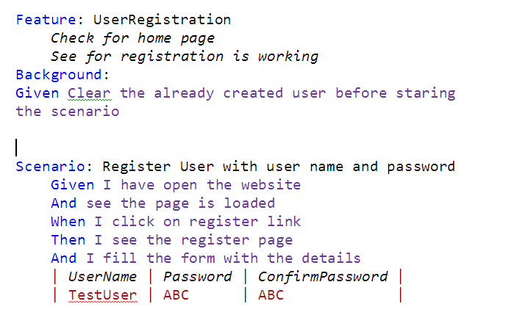
SpecFlow- SYNTAX
The Specflow syntax is as below :

Slide 4
SpecFlow Syntax : Keywords
Feature
Act as the heading for the particular scenario.
Compiler will not execute any line under this feature as it contains only the information
Background
Useful while working with scenario having common functionalities.
This will execute before every scenario and preform the specific operation.
Scenario
This contains the actual test case which we need to execute.
Given
When
Then
And
But
Examples

Slide 5
SpecFlow Installation
Install using nuget package manager in Visual studio.
Add the extension for the nunit/xunit runner.
Add the the specflow extension to the VS IDE.

Slide 6
Demo

